Slide 1
CPSC 5200
Software Architecture and Design

Slide 2
Administration
Email: michaeljon.miller@outlook.com
Phone / text: 425-503-4367
Office hours: Tuesdays, 5 – 6pm, by appointment
Site: https://github.com/michaeljon/SU_CPSC_5200_20WQ
Text: None yet, see book list for recommendations
Note – Remote lecture via zoom on 21st Jan
Note – Guest lectures on 4th and 6th Feb

Slide 3
Who am I to teach this course?
Principle Architect – ovation.io
Chief Technical Officer – InnoWerks, Ltd.
Chief Software Architect – Apptio
Chief Software Architect – Avalara
Chief Technical Officer – TesTrac.com
Principle Software Architect – Dynamics AX
Principle Software Architect – Microsoft Hohm
Software Architect – Dynamics CRM
Founder, chief engineer, chief architect at…

Slide 4
Grading, homework, etc.
95+ points – A
90+ points – B
85+ points – C
< 85 is failing
Mid-term – 15-20% (11th Feb)
Final exam – 25-30% (19th Mar)
Team assignments – 30% (3 papers, 1 presentation)
Individual assignments – 10% (2 TBD)
Individual project – 10% (1 paper, etc.)
Other random work – up to 10% (see above)

Slide 5
Course structure
Lectures, lectures, lectures
I prefer discussion to lecturing
Team project and team assignments
At least one design session
One midterm
One final
Some pop quizzes (please always have paper and pencil in hand)

Slide 6
Topics we’re going after
API design, interfaces, and messages
Fowler’s Analysis patterns & Gang of Four patterns
Distributed systems and service-oriented architecture
Approaches to dealing with existing systems
Reverse engineering and archaeology
Agile and / or software architecture
Development tools
Revisit enterprise patterns

Slide 7
The project
Teams of four people each (# TBD based on class size)
Each team is building the same system
The write-up is in project/README.md
The project is worth 30 points
You will be building a complete system
You will submit 3 architecture / design papers (per team)
Final presentation and demo

Slide 8
One more note…
Architecture is subjective
There is no ”correct” answer
There is no “correct” architecture
There is no “correct” design
This will make you uncomfortable
But… two “correctness” measures
Does the software work?
Are the economics solid?
Maintainable
Sustainable
Scalable
Extensible
…

Slide 9
Any questions so far?

Slide 10
Introduction
We need to start somewhere, this seems like a good place

Slide 11
What is this architecture thing?
Run-time abstraction view
A software architecture is an abstraction of the run-time elements of a software system during some phase of its operation. A system may be composed of many levels of abstraction and many phases of operation, each with its own software architecture.
Elemental view
A software architecture is defined by a configuration of architectural elements - components, connectors, and data - constrained in their relationships in order to achieve a desired set of architectural properties.

Slide 12
So, what elements?
A component is an abstract unit of software instructions and internal state that provides a transformation of data via its interface.
A connector is an abstract mechanism that mediates communication, coordination, or cooperation among components.
A datum is an element of information that is transferred from a component, or received by a component, via a connector.
A configuration is the structure of architectural relationships among components, connectors, and data during a period of system run-time.

Slide 13
Which leaves us with style
An architectural style is a coordinated set of architectural constraints that restricts the roles / features of architectural elements and the allowed relationships among those elements within any architecture that conforms to that style.
Notes:
Don’t confuse this use of the word “style” with its use in describing personalization or fashion. Architectural style as applied to building architecture is closer in nature to that which we’re discussing here, but also tends to reflect the local ruler’s personal tastes. We don’t want personality or taste to govern our architectural decisions.

Slide 14
Styles and patterns
There’s a continuum, and that’s what’s important
This course is all about the continuum
And… you want to talk about controversy…

Slide 15
Let’s look at some examples
These are taken from various projects that I’ve worked on

Slide 16
18-month detailed integration

Slide 17
An “application” in that model

Slide 18
One “layer” in the 18-month model

Slide 19
Logical concept map

Slide 20
C-level model (see the 18-mo. version)

Slide 21
50,000’ C⁻¹-level microservices model

Slide 22
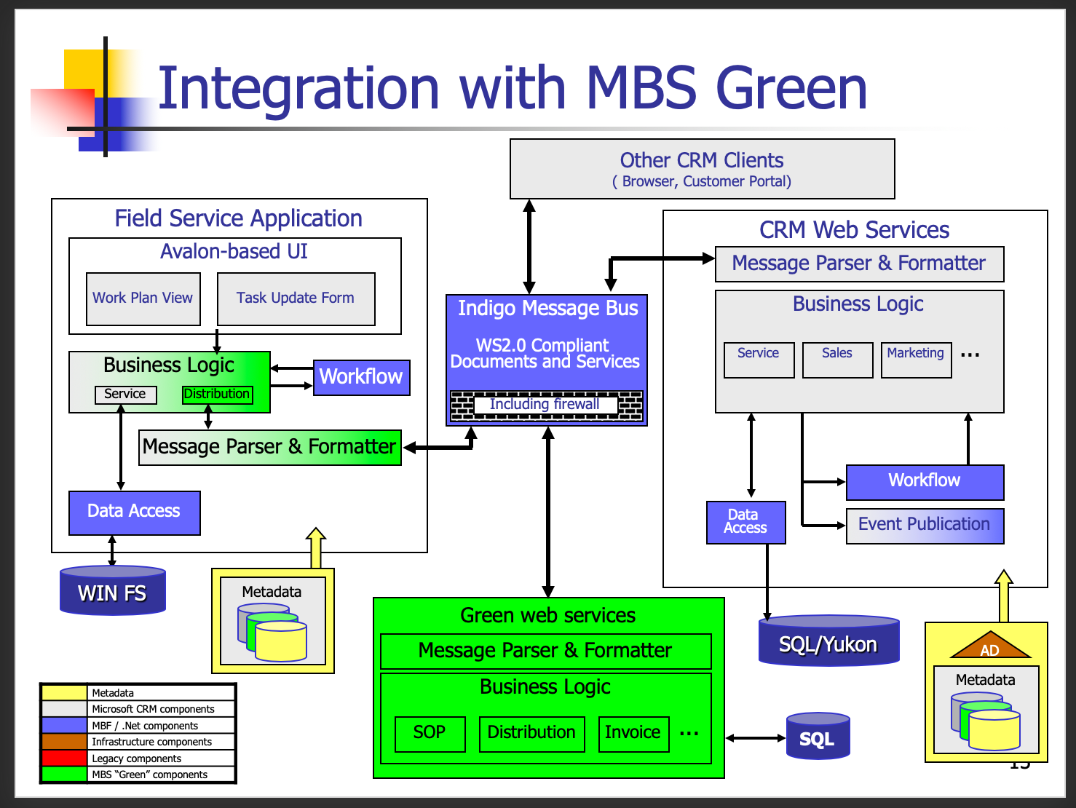
BillG review for ”future” product

Slide 23
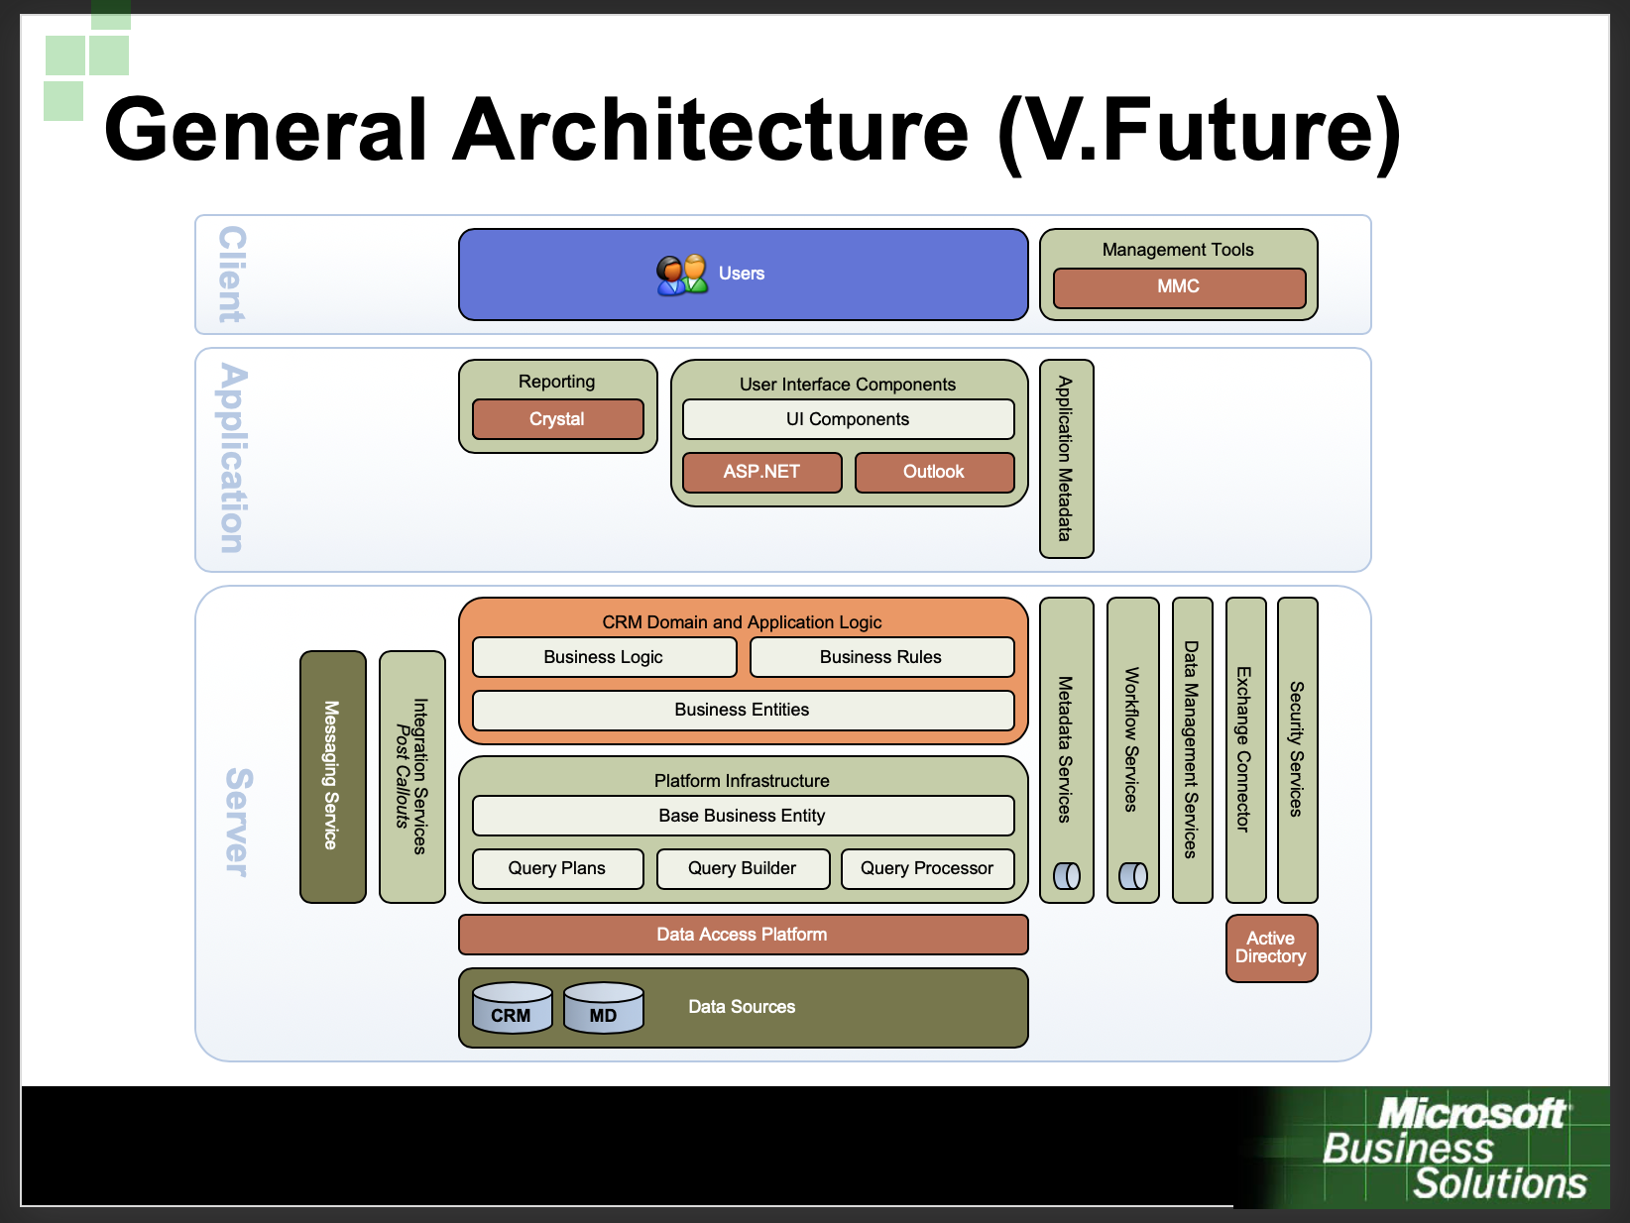
Customer-facing view of previous

Slide 24
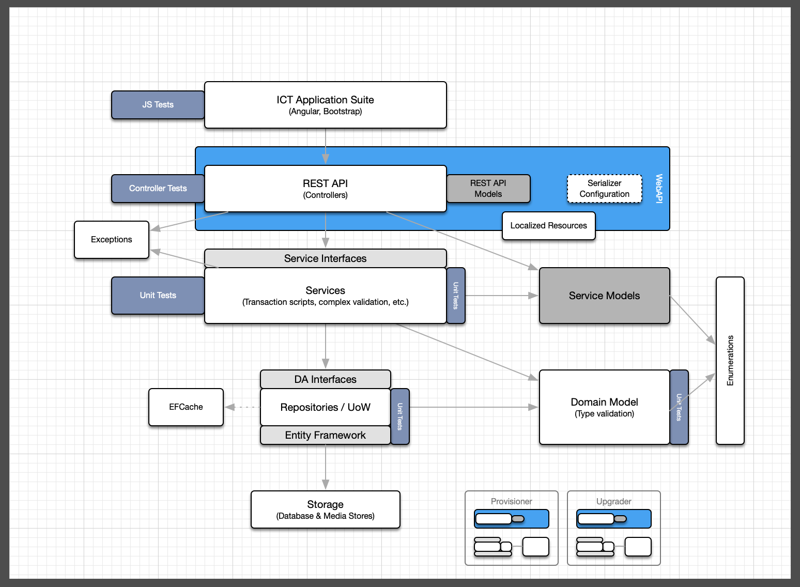
Dev-level “standardized” web app

Slide 25
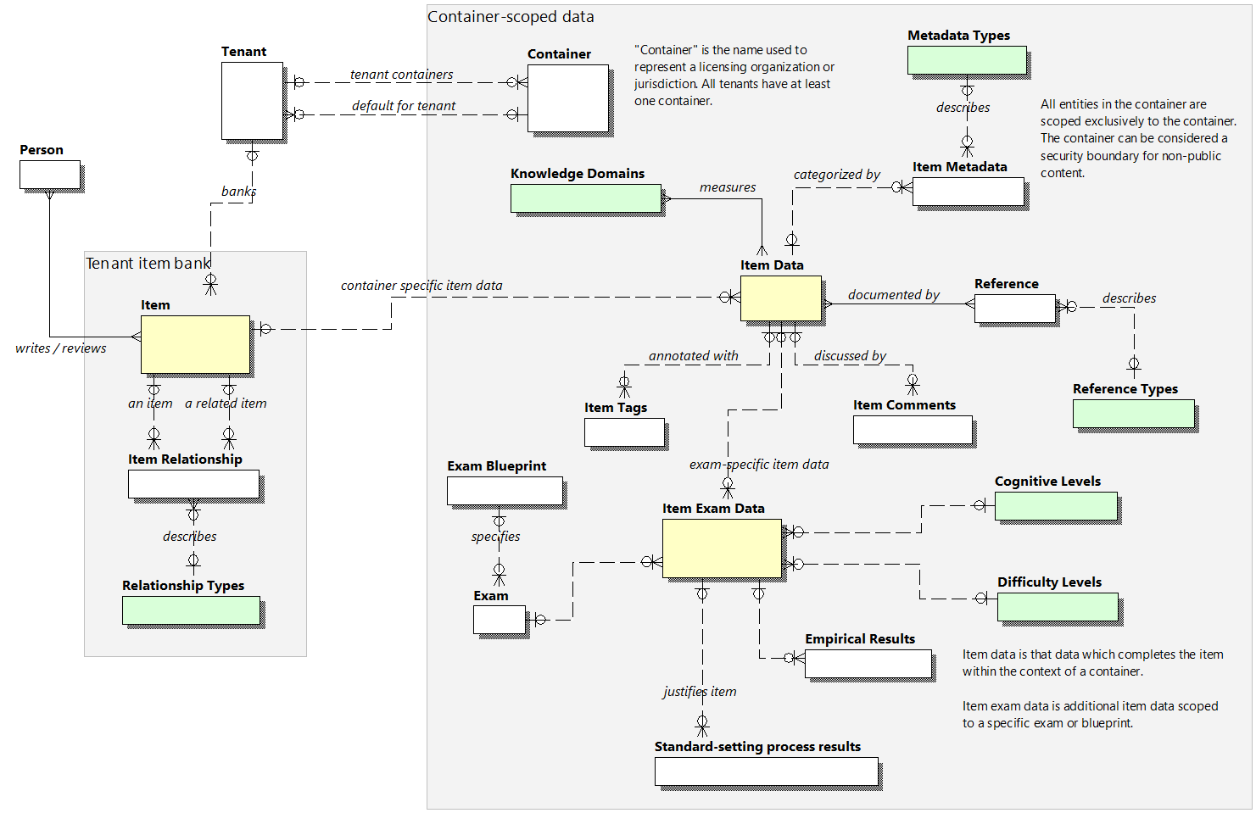
SME-facing concept model

Slide 26
For next time
We are going to cover the REST architectural style
Please read (at least) chapter 5 of Roy Fielding’s dissertation
http://www.ics.uci.edu/~fielding/pubs/dissertation/top.htm
We will look at an implementation of the above (yes, code)

